Slide 1
3D Earth and Moon
Final Computer Graphics
Group 10

Slide 2
Members of Group:
BA10-025
Nguyen Thi Khanh Huyen
BI11-163
Nguyen Duc Minh
Vu Yen Linh
BI11-152
Vi Van Hieu
BI11-019
Nguyen Thi Quynh Anh
BI11-029

Slide 3
01
Table of contents
02
03
Introduction
Programming Language and Library
Design
Flow requirements
References
What is completed or not completed ?

Slide 4
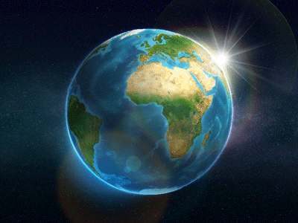
01
Introduction

Slide 5
WHat is 3D earth?
In computer graphics, 3D earth involves creating a digital model of planet Earth that can be manipulated and displayed on a computer screen. This process utilizes specialized software and techniques to generate a high-resolution, lifelike, and immersive digital world. 3D earth models can be used for visualizing geographic data, creating realistic simulations, and generating virtual environments for games and other applications.

Slide 6


Programming Language and Library
JavaScript
4 Libraries (three.js):
EffectComposer
RenderPass
UnrealBloomPass
OrbitControls

Slide 7
02
Design

Slide 8
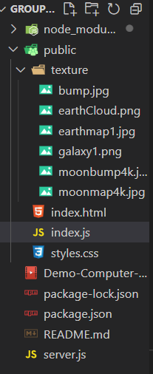
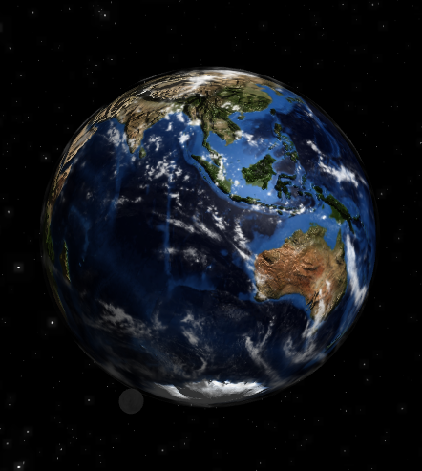
Loading 3D model from files

Slide 9
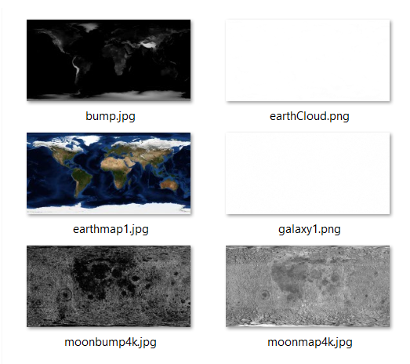
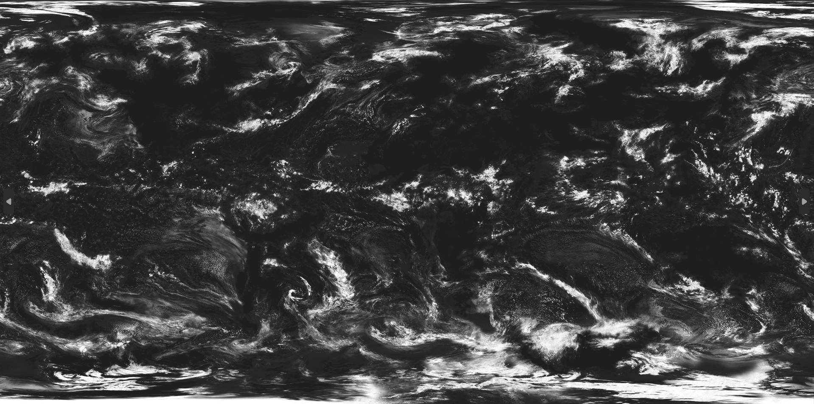
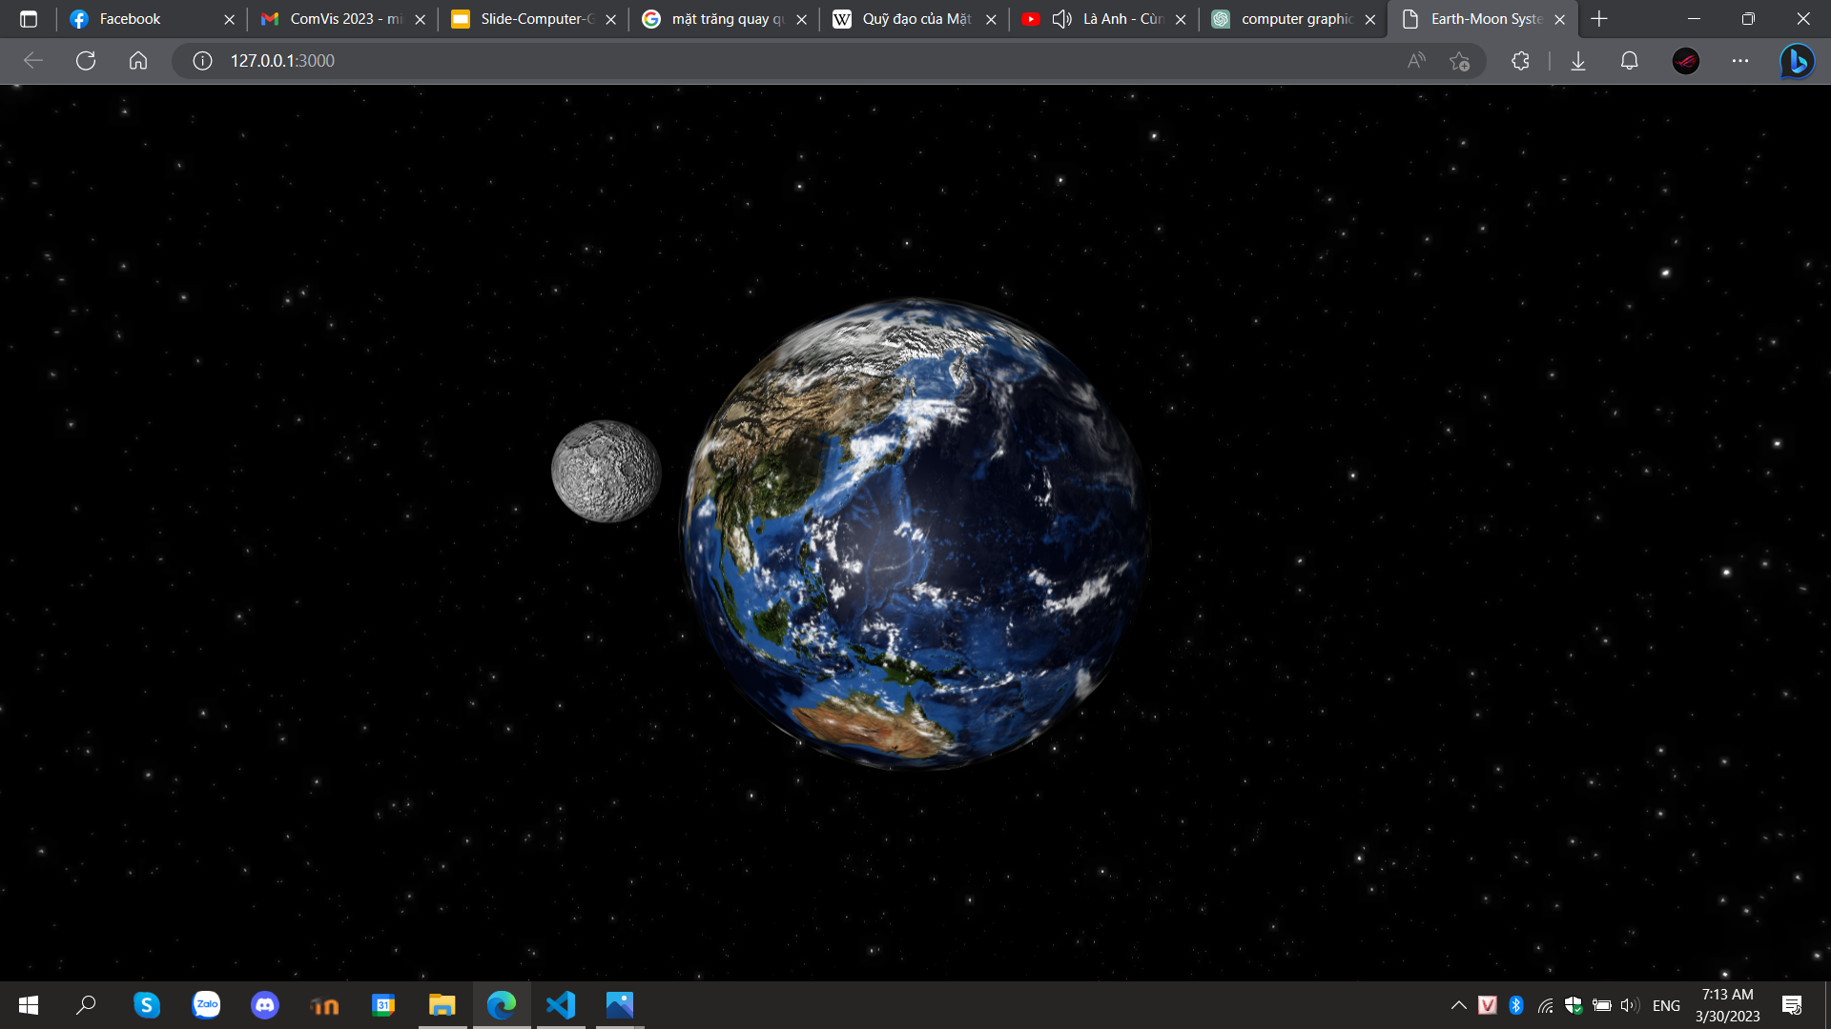

Texturing and Coloring

Slide 10
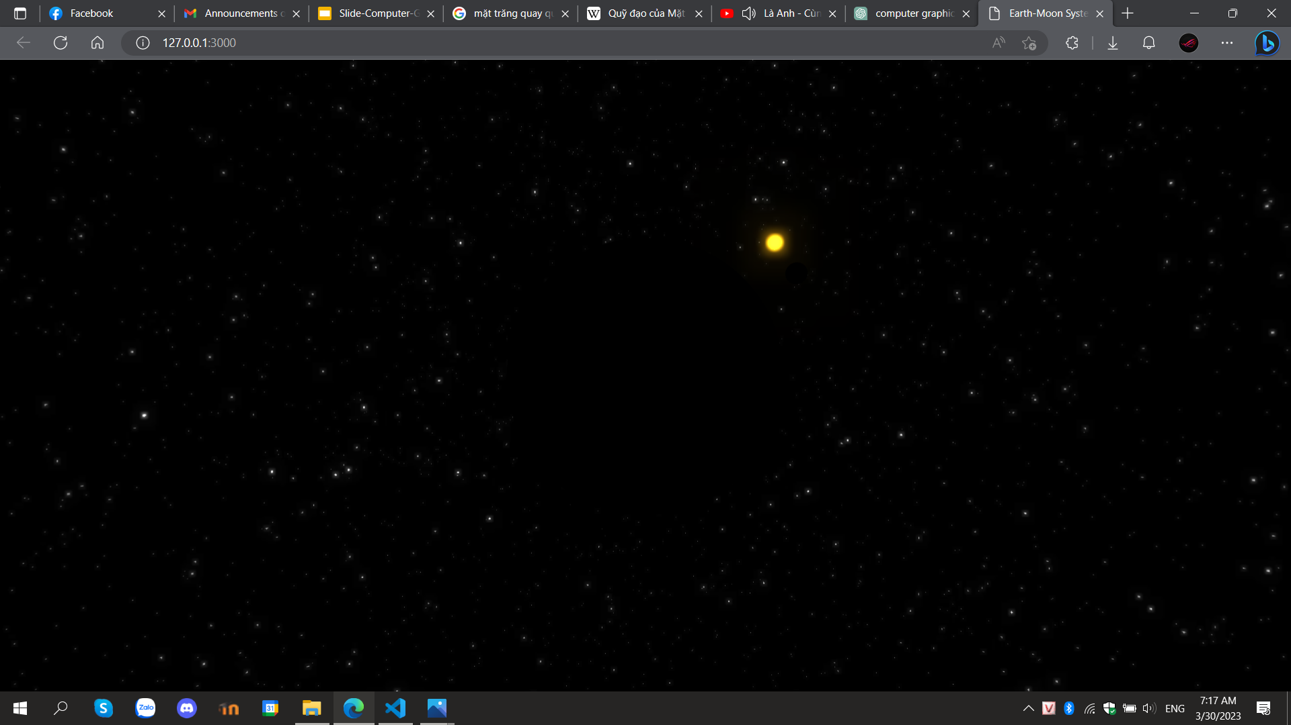
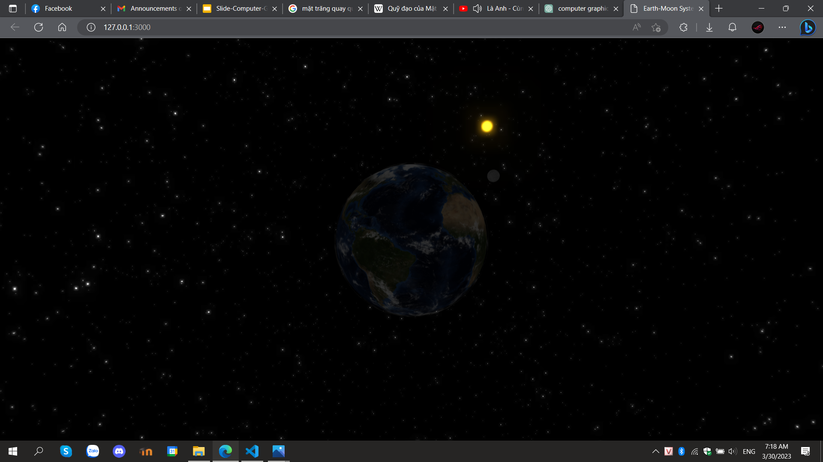
Illumination & Lightning
Before we add light
After we add ambient light but no point the light
After we add both ambient light and point light

Slide 11
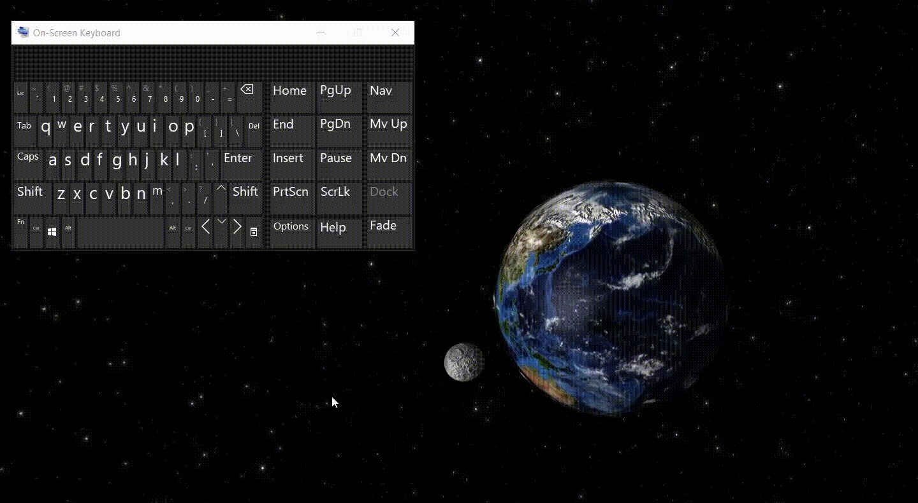
Keyboard and Mouse interaction
Zoom in/ Zoom out
Rotate 360°

Slide 12
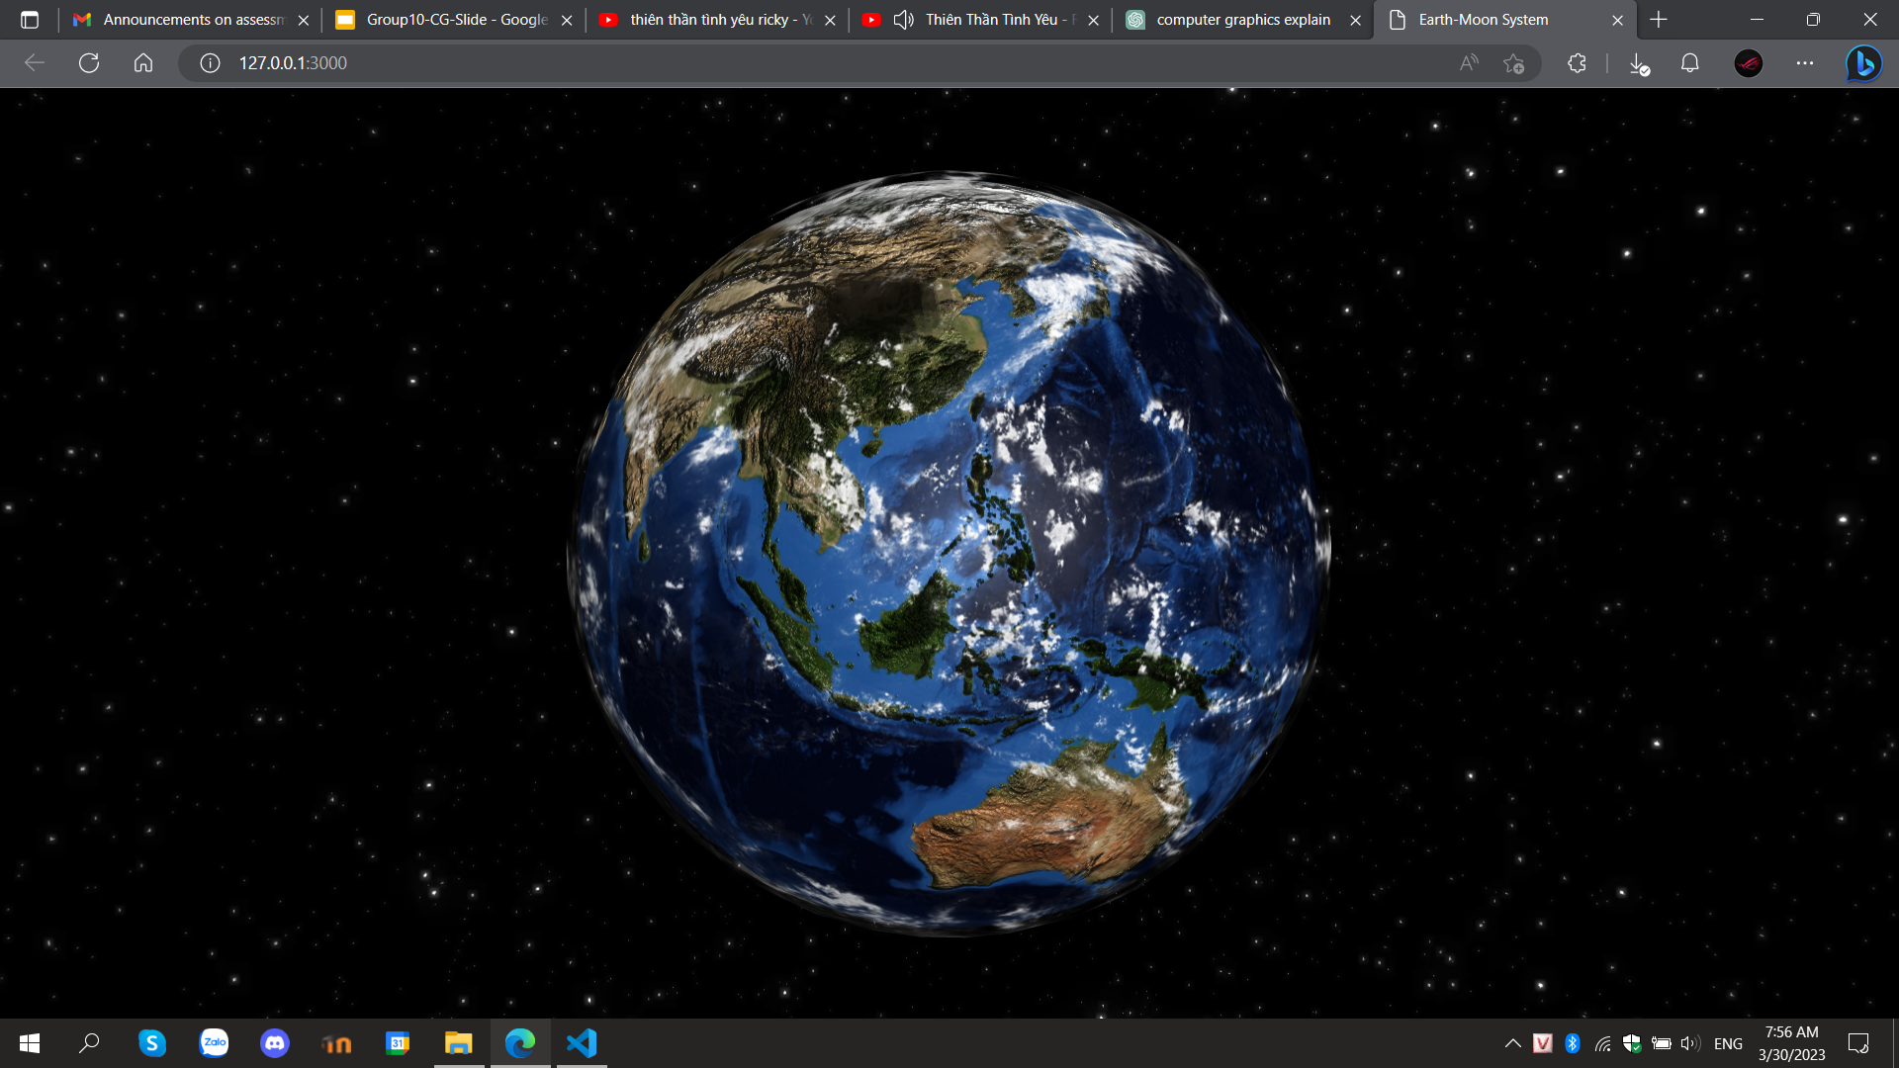
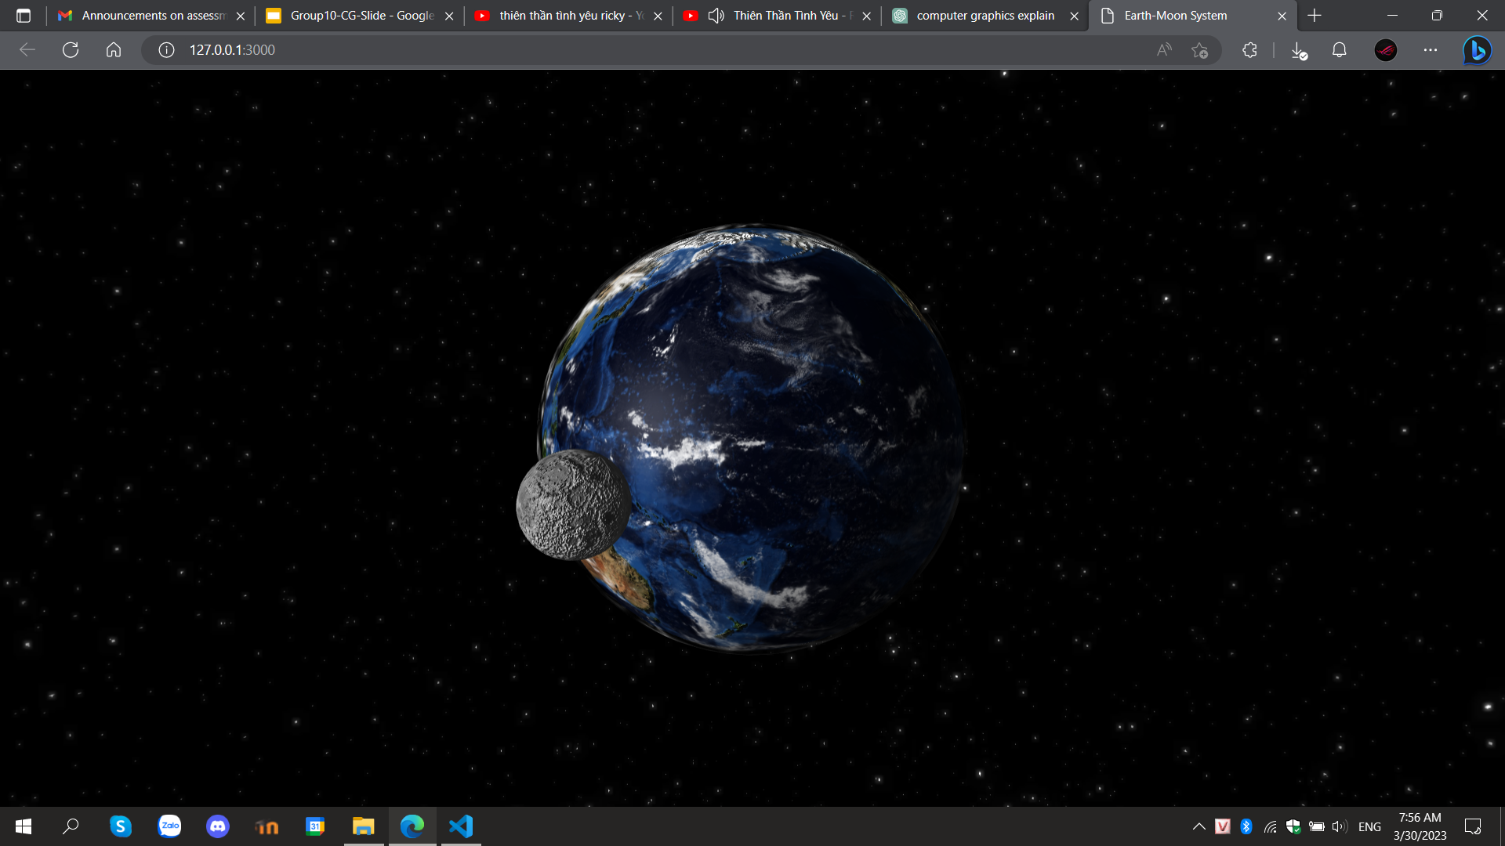
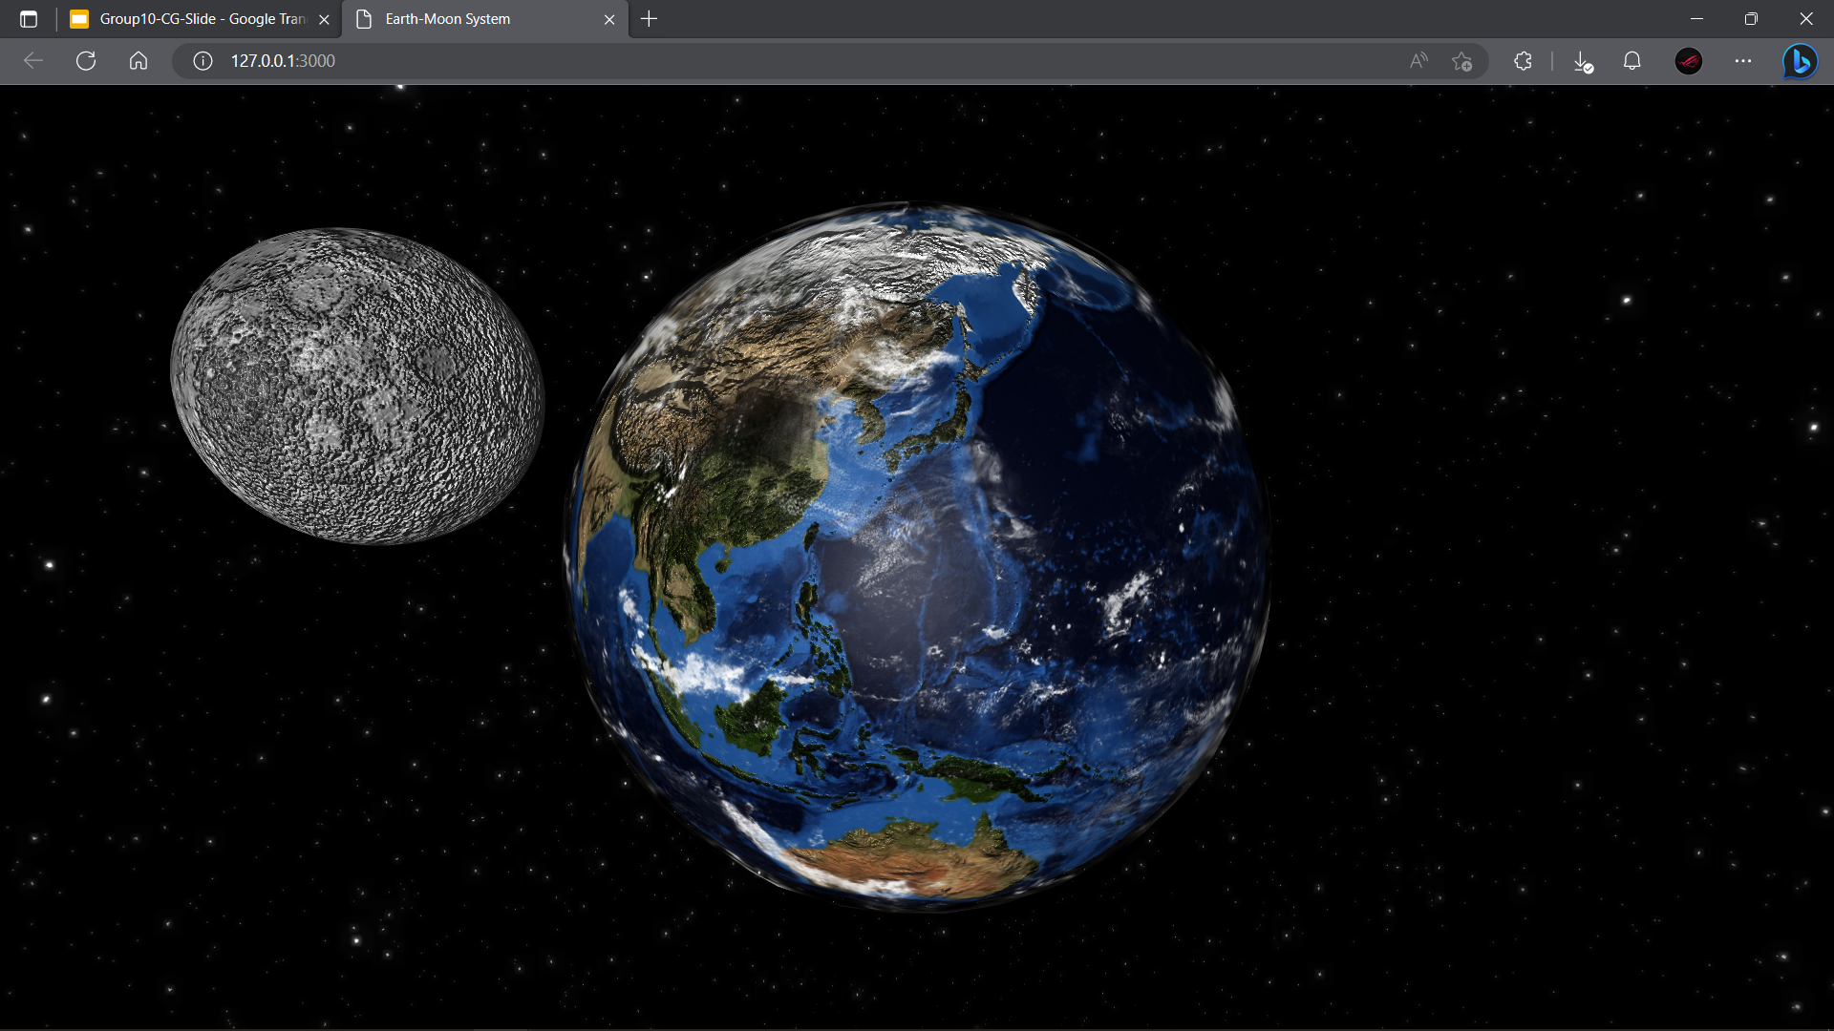
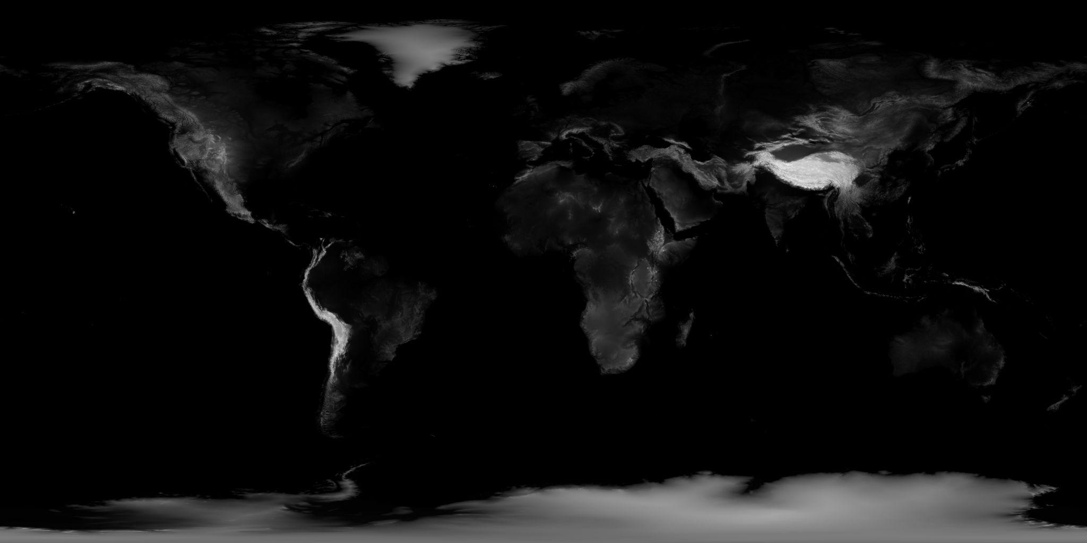
Advanced Techniques
Animation
Surface
Shader
Bump-Map

Slide 13
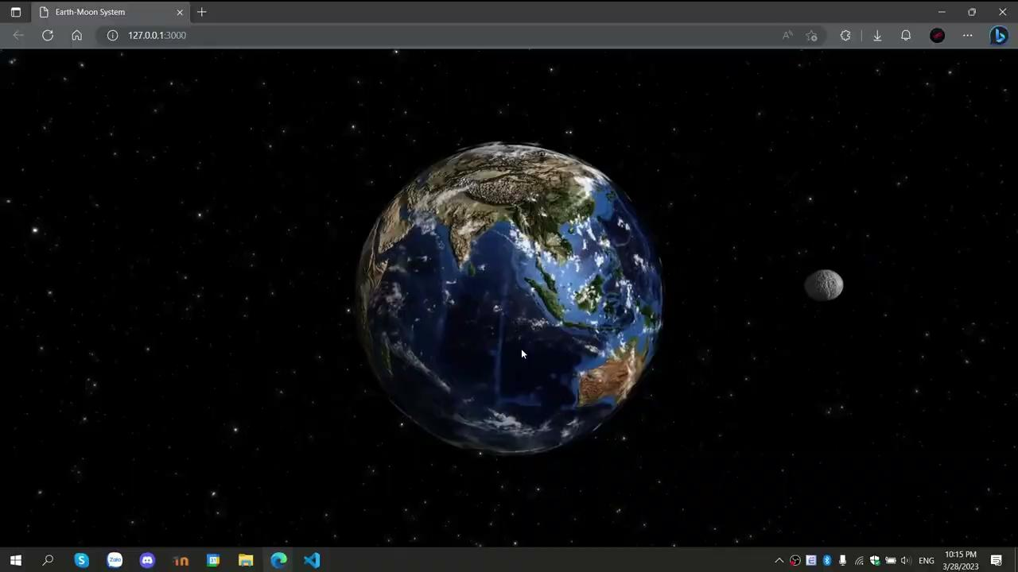
DEMO

Slide 14
03
References

Slide 15
What did we do beside learning tutorial
Resources:
Learning how to make Earth realistic in 3D by shape, color, animation texture,....
Pictures from open resources for texture (surface, cloud, galaxy,...).
Understanding function how Earth rotate by it self through their code.
Learn function of Threejs library.
Self-study-make:
Use the function but change the texture by looking for other open sources, adjusting the parameters.
Apply knowledge to create moon and sun. Also create an axis of rotation for the moon around the earth.
Change that earth will stay still and the camera will rotation instead of resources.
Keyboard and mouse interaction.
Source Code: https://github.com/ngducminh/CG-Group10.git

Slide 16
Thanks!
Do you have any questions?

